Slide 1



Visa Workforce Dashboard
View in Power BI
Last data refresh:
2/8/2023 11:30:41 AM UTC
Downloaded at:
2/10/2023 3:17:54 PM UTC

Slide 2
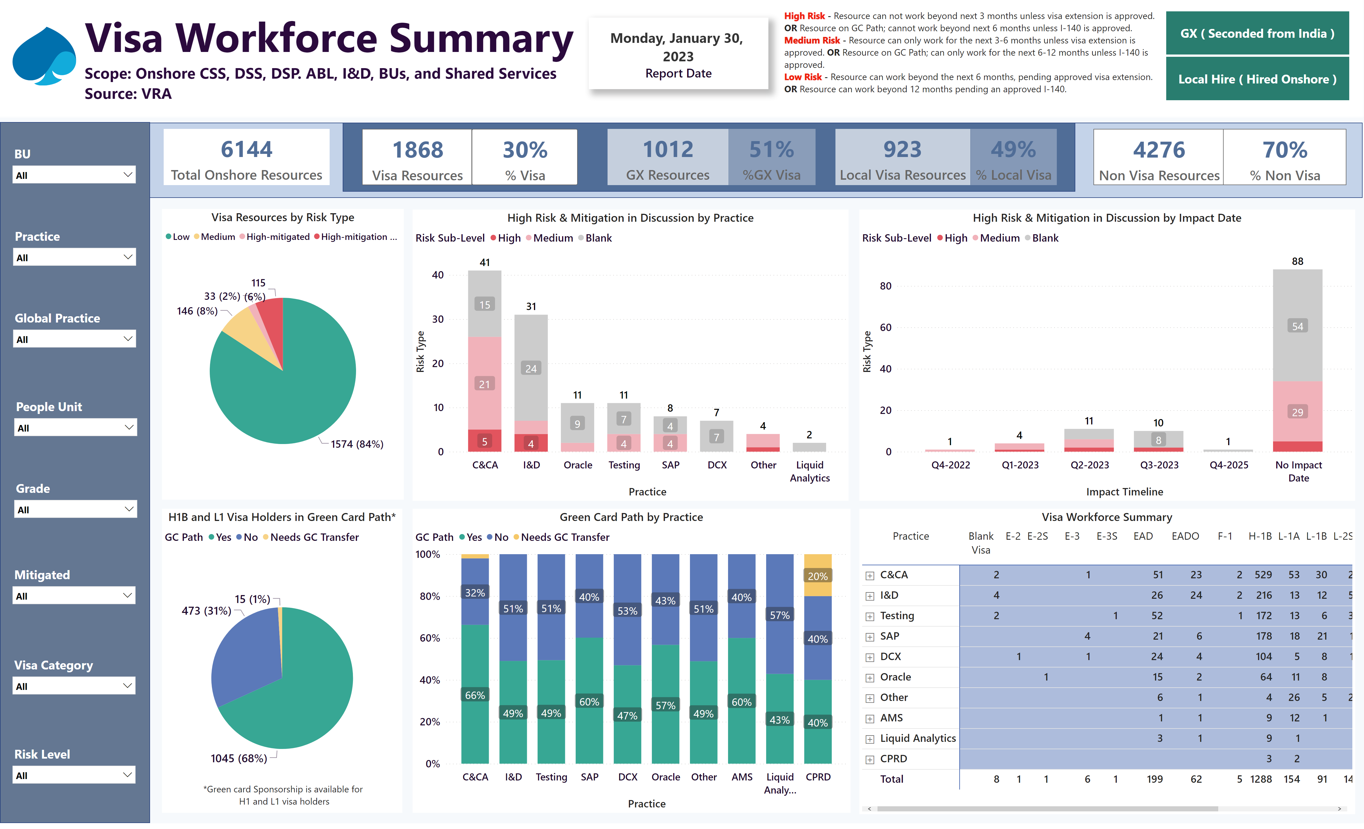
VISA Workforce Summary
Notes:
card
No alt text provided
slicer
No alt text provided
High Risk & Mitigation in Discussion by Practice
No alt text provided
Green Card Path by Practice
No alt text provided
Visa Resources by Risk Type
No alt text provided
slicer
No alt text provided
card
No alt text provided
textbox
No alt text provided
shape
No alt text provided
card
No alt text provided
card
No alt text provided
shape
No alt text provided
slicer
No alt text provided
slicer
No alt text provided
slicer
No alt text provided
slicer
No alt text provided
slicer
No alt text provided
slicer
No alt text provided
card
No alt text provided
card
No alt text provided
card
No alt text provided
slicer
No alt text provided
textbox
No alt text provided
Cap Logo
No alt text provided
textbox
No alt text provided
High Risk & Mitigation in Discussion by Impact Date
No alt text provided
shape
No alt text provided
H1B and L1 Visa Holders in Green Card Path*
No alt text provided
Visa Workforce Summary
No alt text provided
actionButton
No alt text provided
As of:
No alt text provided
card
No alt text provided
card
No alt text provided

